Slide 1
Lazy Leaves
Theme: Beta_24
National Institute of Technology, Bhopal(MANIT)
TEAM MEMBERS:
Mayank Patel
Anant K Joshi
Atik Agrawal
Vedant Mathe

Slide 2
Problem Statement
Problem Statement 5 - Offline Map Helper
To create a service to get directions without internet
using SMS.

Slide 3
Proposed Solution
Simpli-Map : Maps made Simple
It is a Offline SMS service which helps in finding the routes from source to destination entered by the user.
The user can search for the route by sending his current location and destination location . After querying the sms string, the directions will be received by the user again via SMS.

Slide 4





Demo Video Link :
https://drive.google.com/file/d/1RBpfGjPpaXsacvZbxlaymnOyjzaH-hIQ/view?usp=drivesdk
Tech Stack/API
Python
Nltk
Natural Language Processing (NLP)
Twilio-SMS-API
MapQuest Api
Open Street Api
Intellexer Api
AWS lambda
AWS API Gateway

Slide 5
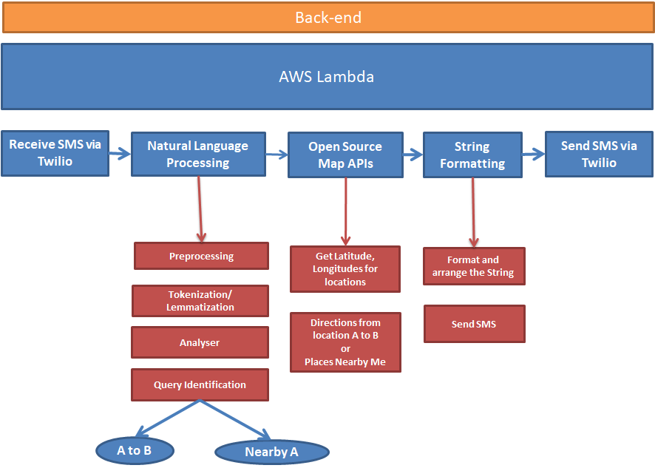
Implementation: High level design(HLD)

Slide 6
Implementation
First we are creating a messaging service using Twilio.
The received message is then pre-processed to remove any unwanted symbols and words.
The query is then extracted from the pre-processed data .
The source and destination locations are then identified from the query.

Slide 7
Some Example Queries
Get directions from <A> to <B>
from indore to bhopal
Take me to goa from mumbai
take me from howrah bridge to dumdum kolkata
I wish to go to bhopal from indore
from chennai to Banglore
Show me directions from Mata Mandir Bhopal to palasia Indore
Take me from palasia indore to bhopal
get directions from Victoria Memorial Kolkata to Howrah Bridge
Route me to Howrah Bridge from Lake town kolkata
get directions from andheri mumbai to bandra mumbai
<Places> around/near <A>
restaurants near palasia indore
Search for Schools near Tatibandh Raipur
cafes near manit bhopal
banks near Bandra Mumbai
restaurants near mata mandir bhopal
restaurants near manit bhopal
Search mall around palasia indore
Look for popular cafes near Nariman point mumbai
Is there any good college around Howrah Bridge kolkata
Doctors near Victoria Memorial Kolkata
what are the banks near mata mandir bhopal
Cafes near Taj Hotel mumbai

Slide 8
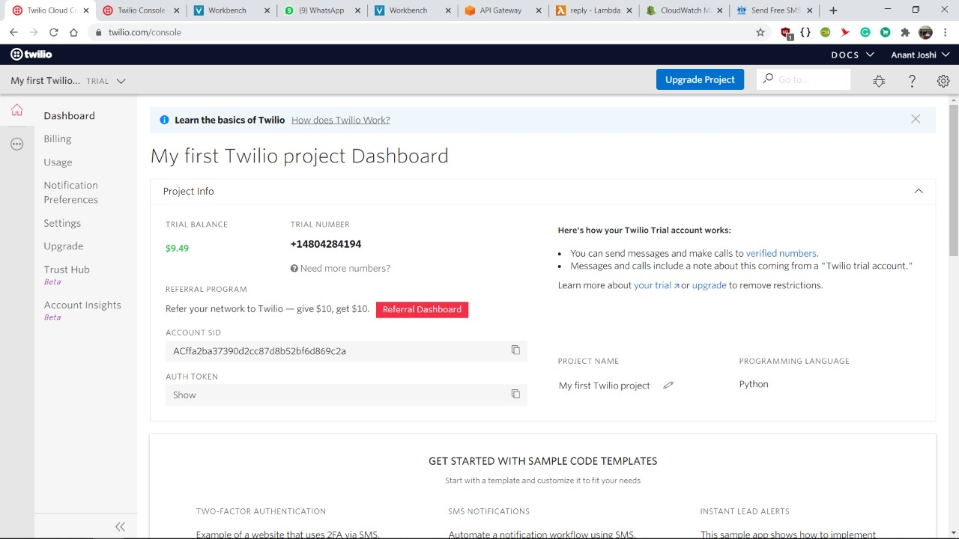
Twilio web service dashboard

Slide 9
Implementation
The longitudes and latitudes of source and destination are then fetched using Open Street Map Api.
After this the directions are fetched using the Mapquest Api require as longitude and latitude as parameters.
The fetched directions are then sent to the user using Twilio and AWS lambda.
An additional feature for searching nearby places has also been implemented.

Slide 10
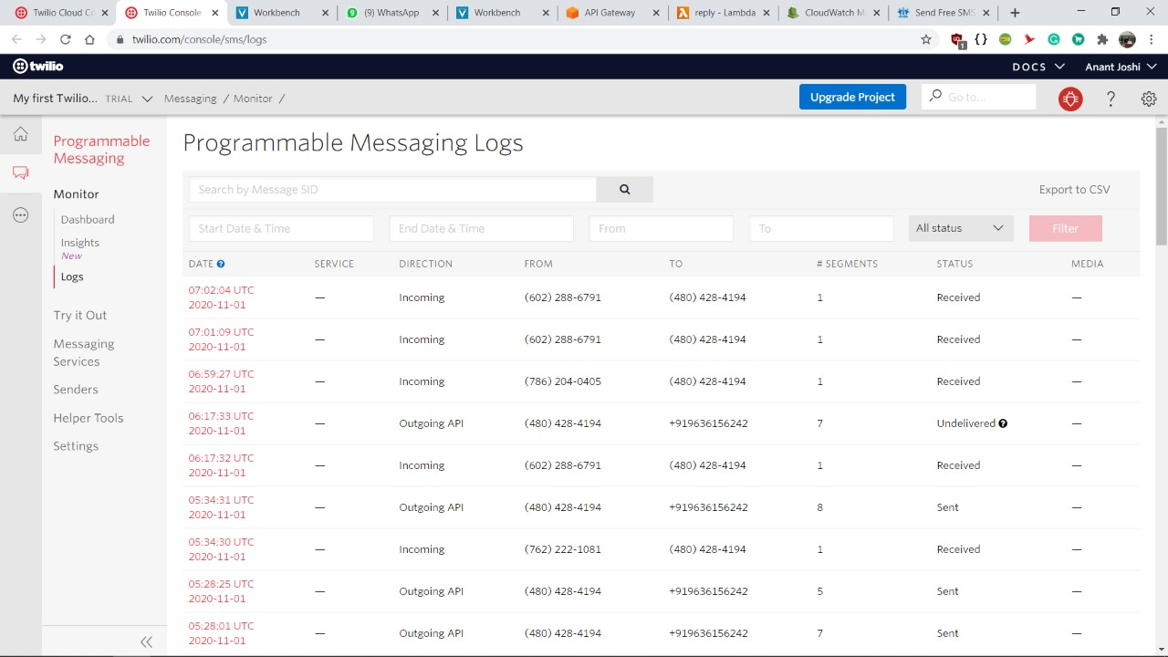
Incoming and Outgoing sms logs from Twilio Web Service

Slide 11
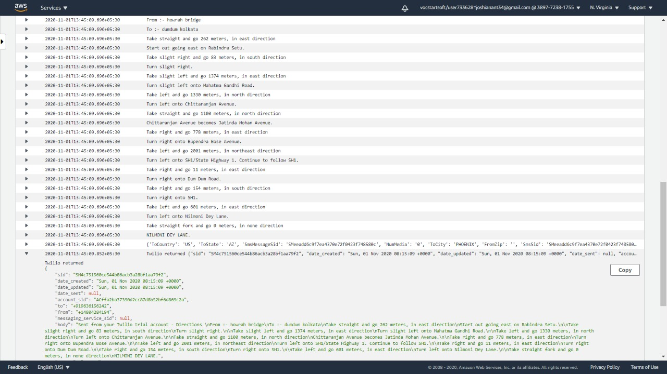
AWS Lambda logs corresponding to the query :
“Take me from Howrah Bridge to Dumdum Kolkata”

Slide 12
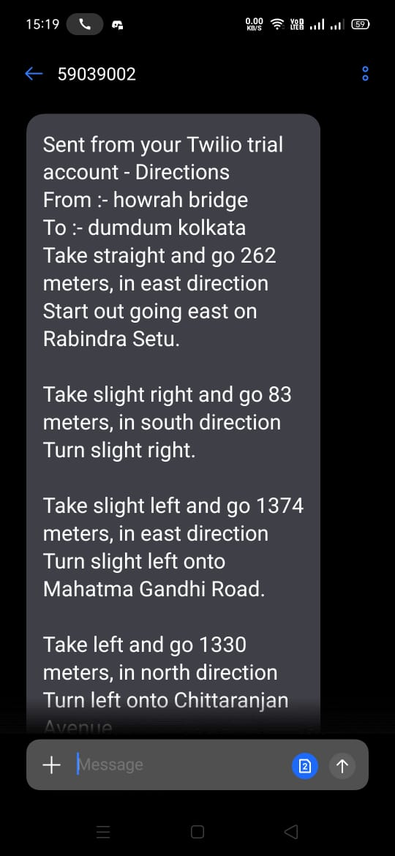
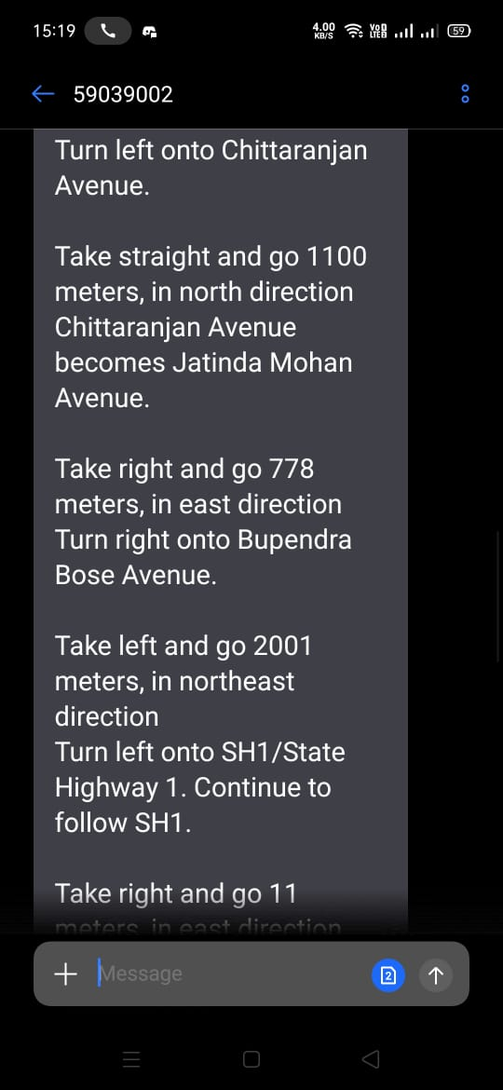
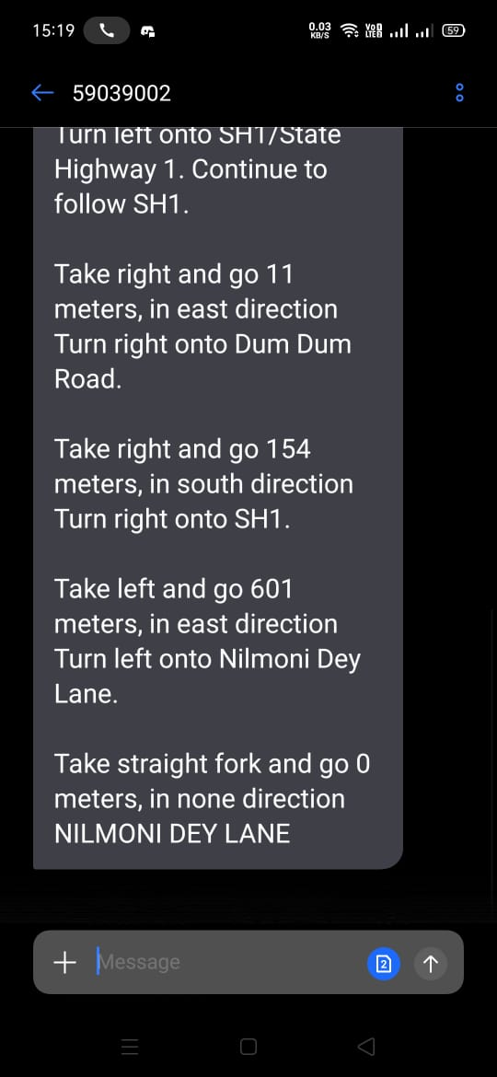
Query: Take me from Howrah Bridge to Dumdum Kolkata

Slide 13
Innovation(What makes us different?)
Queries are accepted in the form of simple English sentences rather than any fixed format.
The messaging service developed by our team is totally platform independent and only need a simple mobile phone having capability for sending SMS.
That’s All You Need !!!!
By doing so we are able to target complete set of audience and we are also able to remove the technology barrier
We are live !!
Our product is deployed on AWS.

Slide 14
Scalability
As of now we are using free messaging api due to which we have limited access to the number for sending queries.
So, we can use a premium account for messaging service for increasing the efficiency for sending and receiving SMS.
In future we can also consider of making an app for sending messages using gps location which will improve GUI and precision in results.
We can also try to improve our NLP processing over queries to extract the meaning information more precisely consequently leading to more accuracy of the model.

Slide 15
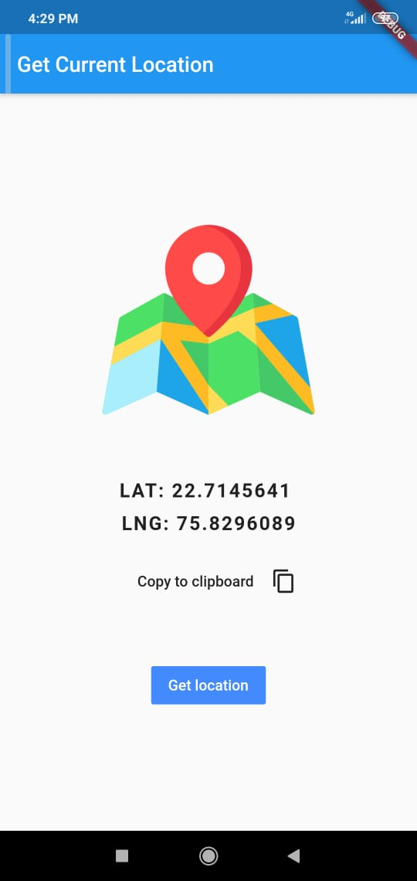
One More Thing..
If you don’t even know your location, you can get the longitude and latitude using our mobile application

Slide 16
THANK YOU

